Slide 1
Classification
- Part 1 –
Data Mining
Instructor :Dr. Hina Shakir

Slide 2
Decision Tree Classifiers
Root of tree
Attribute tests (splitting attributes)
Refund
Yes
No
NO
MarSt
Single, Divorced
Married
Leaf node (decisions)
TaxInc
NO
< 80K
> 80K
NO
YES
Decision trees encode a procedure for taking a classification decision

Slide 3
Applying a Decision Tree to Unseen Data
Unseen Record
Start from the root of tree
Refund | Marital Status | Taxable Income | Cheat
No | Married | 80K | ?
Refund
10
Yes
No
NO
MarSt
Single, Divorced
Married
Assign Cheat to “No”
TaxInc
NO
< 80K
> 80K
NO
YES

Slide 4









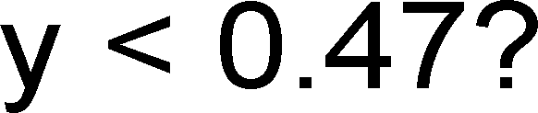
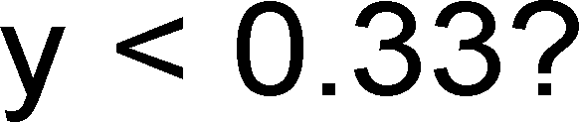














Decision Boundary
x<0.43
y<0.47
y<0.33
The decision boundaries are parallel to the axes because the test condition involves a single attribute at-a-time

Slide 5
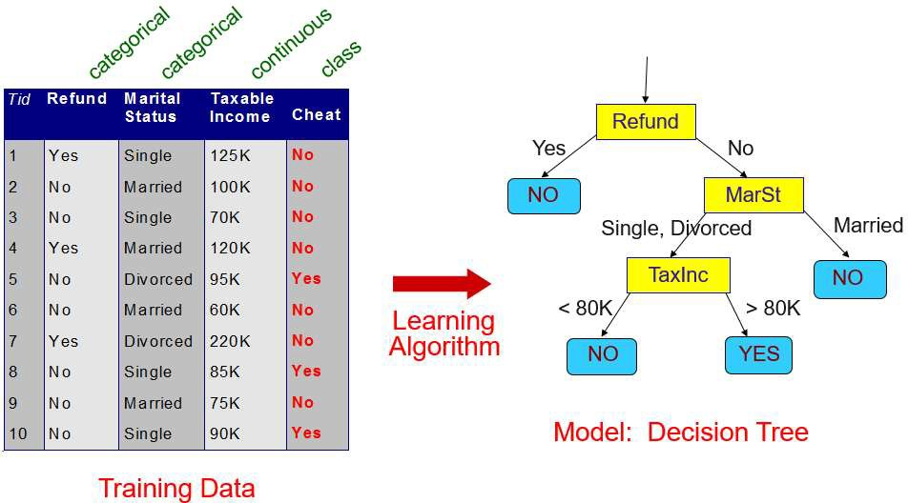
Learning a Decision Tree
How to learn a decision tree from training data?
finding an optimal decision tree is NP-hard
tree building algorithms thus use a greedy, top-down, recursive partitioning strategy to induce a reasonable solution
Many different algorithms have been proposed:
Hunt’s Algorithm
ID3
C4.5
CHAID

Slide 6
Hunt’s Algorithm
Let D_{t} be the set of training records that reach a node t
Generate leaf node or attribute test:
D
t
if D_{t} only contains records that belong to the same class y_{t}, then t is a leaf node labeled as y_{t}
if D_{t} contains records that belong to more than one class, use an attribute test to split the data into subsets having a higher purity.
?
Sub
1
Sub
2
Sub
3
for all possible tests: calculate purity of the resulting subsets
choose test resulting in highest purity
− Recursively apply this procedure to each subset

Slide 7
Hunt’s Algorithm – Step 1
All Training Records
Refund
Tid | Refund | Marital Status | Taxable Income | Cheat
1 | Yes | Single | 125K | No
2 | No | Married | 100K | No
3 | No | Single | 70K | No
4 | Yes | Married | 120K | No
5 | No | Divorced | 95K | Yes
6 | No | Married | 60K | No
7 | Yes | Divorced | 220K | No
8 | No | Single | 85K | Yes
9 | No | Married | 75K | No
10 | No | Single | 90K | Yes
Yes
No
Don’t Cheat
??
We calculate the purity of the resulting subsets for all possible splits
Purity of split on Refund
Purity of split on Marital Status
Purity of split on Taxable Income
We find the split on Refund to produce the purest subsets
10

Slide 8
Hunt’s Algorithm – Step 2
Refund
Tid | Refund | Marital Status | Taxable Income | Cheat
2 | No | Married | 100K | No
3 | No | Single | 70K | No
5 | No | Divorced | 95K | Yes
6 | No | Married | 60K | No
8 | No | Single | 85K | Yes
9 | No | Married | 75K | No
10 | No | Single | 90K | Yes
All Training Records
Yes
No
Don’t Cheat
??
Refund=No Records
Refund
Yes
No
Don’t Cheat
Marital Status
10
We further examine the Refund=No records
Again, we test all possible splits
We find the split on Marital Status to produce the purest subsets
Single, Divorced
Married
??
Don’t Cheat

Slide 9
Hunt’s Algorithm – Step 3
Tid | Refund | Marital Status | Taxable Income | Cheat
3 | No | Single | 70K | No
5 | No | Divorced | 95K | Yes
8 | No | Single | 85K | Yes
10 | No | Single | 90K | Yes
All Training Records
Refund
Yes
No
Don’t Cheat
??
10
Refund
We further examine the Marital Status=Single or =Divorced records
We find a split on Taxable Income
to produce pure subsets
We stop splitting as no sets containing different classes are left
Refund
Yes
No
Yes
No
Don’t Cheat
Marital Status
Don’t Cheat
Marital Status
Single, Divorced
Married
Single, Divorced
Married
Taxable Income
Don’t Cheat
??
Don’t Cheat
< 80K
>= 80K
Refund=No
Marital = Single, Divorced
Records
Don’t Cheat
Cheat

Slide 10
Design Issues for Learning Decision Trees
How should training records be split?
How to specify the attribute test condition?
Depends on number of ways to split: 2-way split, multi-way split
Depends on attribute data type: nominal, ordinal, continuous
How to determine the best split?
Different purity measures can be used
When should the splitting procedure stop?
Shallow trees might generalize better to unseen records
Fully grown trees might overfit training data

Slide 11
Splitting Based on Nominal Attributes
− Multi-way split: Use as many partitions as distinct values
CarType
Family
Luxury
Sports
− Binary split: Divides values into two subsets
CarType
CarType
{Sports, Luxury}
OR
{Family, Luxury}
{Family}
{Sports}

Slide 12
Splitting Based on Ordinal Attributes
− Multi-way split: Use as many partitions as distinct values
Size
Small
Large
Medium
− Binary split: Divides values into two subsets while
keeping the order
Size
OR
Size
{Small, Medium}
{Medium, Large}
{Large}
{Small}

Slide 13
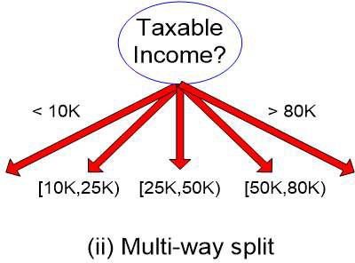
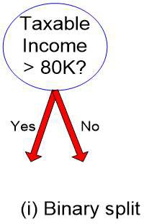
Splitting Based on Continuous Attributes
Different ways of handling continuous attributes
Discretization to form an ordinal categorical attribute
equal-interval binning
equal-frequency binning
binning based on user-provided boundaries
Binary Decision: (A < v) or (A ≥ v)
usually sufficient in practice
find the best splitting border v based on a purity measure (see below)
can be compute intensive

Slide 14
Discretization Example
Values of the attribute, e.g., age of a person:
0, 4, 12, 16, 16, 18, 24, 26, 28
Equal-interval binning – for bin width of e.g., 10:
Bin 1: 0, 4
Bin 2: 12, 16, 16, 18
Bin 3: 24, 26, 28
[-,10) bin
[10,20) bin
[20,+) bin
– denote negative infinity, + positive infinity
− Equal-frequency binning – for bin density of e.g., 3:
Bin 1: 0, 4, 12
Bin 2: 16, 16, 18
Bin 3: 24, 26, 28
[-, 14) bin
[14, 21) bin
[21,+] bin

Slide 15
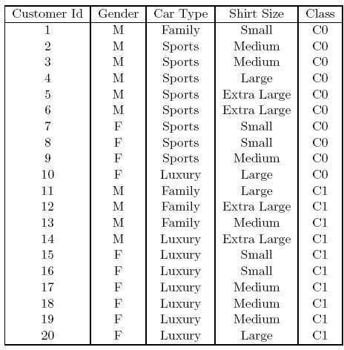































3.2 How to Find the Best Split?
Before splitting the dataset contains:
10 records of class C0 and
10 records of class C1
Which attribute test is the best?

Slide 16

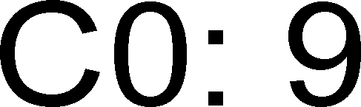


How to Find the Best Split?
Greedy approach: Test all possible splits and use the one that results in the most homogeneous (= pure) nodes
Need a measure of node impurity:
Non-homogeneous High degree of node impurity
Homogeneous
Low degree of node impurity
Common measures of node impurity:
GINI Index
Entropy

Slide 17
How to Find the Best Split?
Compute impurity measure (P) before splitting
Compute impurity measure (M) after splitting for all possible splits
compute impurity measure of each child node
M is the weighted impurity of children
Choose the attribute test condition (split) that produces the highest purity gain
Gain = P – M
or equivalently, lowest impurity measure after splitting (M)

Slide 18
Comparing Two Splits by Purity Gain
Before Splitting:
C0 | N00
C1 | N01
P
A?
B?
Yes
No
Yes
No
Node N1
Node N2
Node N3
Node N4
C0 | N10
C1 | N11
C0 | N20
C1 | N21
C0 | N30
C1 | N31
C0 | N40
C1 | N41
M1
M2 M3
M12
Higher purity gain? P – M12 or P – M34
M4
M34

Slide 19
Impurity Measure: GINI Index
− GINI Index for a given node t :
GINI (t) = 1 − ∑[ p( j | t)]²
j
p( j | t) is the relative frequency of class j at node t
Minimum (0.0) when all records belong to one class
Maximum (1 - 1/n_{c}) when records are equally distributed among all classes. n_{c} = number of classes
C1 | 0
C2 | 6
Gini=0.000
C1 | 1
C2 | 5
Gini=0.278
C1 | 2
C2 | 4
Gini=0.444
C1 | 3
C2 | 3
Gini=0.500

Slide 20
Examples for computing GINI
GINI (t) = 1 − ∑[ p( j | t)]²
j
P(C1) = 0/6 = 0 P(C2) = 6/6 = 1
Gini = 1 – P(C1)² – P(C2)² = 1 – 0 – 1 = 0
P(C1) = 1/6 P(C2) = 5/6 Gini = 1 – (1/6)² – (5/6)² = 0.278
P(C1) = 2/6 P(C2) = 4/6 Gini = 1 – (2/6)² – (4/6)² = 0.444
C1 | 0
C2 | 6
C1 | 1
C2 | 5
C1 | 2
C2 | 4

Slide 21
Splitting Based on GINI
When a node p is split into k partitions (subsets),
the GINI index of each partition is weighted according to the partition's size
The quality of the overall split is computed as:
k
GINI = ∑
^{ni} GINI (i)
n
split
i =1
where: n_{i} = number of records at child i n = number of records at node p

Slide 22
Example: Calculating the Purity Gain of a Split
Split into two partitions
B?
 | Parent
C1 | 6
C2 | 6
Gini = 0.500
Yes
No
Node N1
Node N2
GINI_{N1}
= 1 – (5/7)² – (2/7)²
= 0.408
GINI_{N2}
= 1 – (1/5)² – (4/5)²
= 0.32
 | N1 | N2
C1 | 5 | 1
C2 | 2 | 4
Gini=0.371
GINI
Split
= 7/12 * 0.408 + 5/12 * 0.32
= 0.371
Weights
Purity Gain = 0.5 – 0.371 = 0.129

Slide 23
Categorical Attributes: Computing Gini Index
For each distinct attribute value, gather counts for each class
Multi-way split
Two-way split
(find best partition of values)
 | CarType
 | Family | Sports | Luxury
C1 | 1 | 2 | 1
C2 | 4 | 1 | 1
Gini | 0.393
 | CarType
 | {Sports, Luxury} | {Family}
C1 | 3 | 1
C2 | 2 | 4
Gini | 0.400
 | CarType
 | {Sports} | {Family, Luxury}
C1 | 2 | 2
C2 | 1 | 5
Gini | 0.419

Slide 24


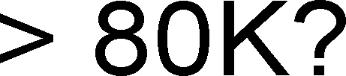


Continuous Attributes: Computing Gini Index
How to find the best binary split for a continuous attribute?
Efficient computation:
sort the attribute on values
choose split positions at the middle between two values
linearly scan these values, each time updating the count matrix and computing the gini index
choose the split position that has the smalest gini index
Sorted Values
Split Positions
 | Taxable Income
 | 60 |  |  | 70 |  |  | 75 |  | 85 |  |  | 90 |  |  | 95 |  | 100 |  | 120 |  | 125 |  | 220
 | 55 |  | 65 |  |  | 72 |  | 80 |  |  | 87 |  |  | 92 |  | 97 |  | 110 |  | 122 |  | 172 |  | 230
 | <= | > | <= |  | > | <= | > | <= |  | > | <= |  | > | <= | > | <= | > | <= | > | <= | > | <= | > | <= | >
Yes | 0 | 3 | 0 |  | 3 | 0 | 3 | 0 |  | 3 | 1 |  | 2 | 2 | 1 | 3 | 0 | 3 | 0 | 3 | 0 | 3 | 0 | 3 | 0
No | 0 | 7 | 1 |  | 6 | 2 | 5 | 3 |  | 4 | 3 |  | 4 | 3 | 4 | 3 | 4 | 4 | 3 | 5 | 2 | 6 | 1 | 7 | 0
Gini | 0.420 |  | 0.400 |  |  | 0.375 |  | 0.343 |  |  | 0.417 |  |  | 0.400 |  | 0.300 |  | 0.343 |  | 0.375 |  | 0.400 |  | 0.420

Slide 25
Alternative Impurity Measure: Information Gain
Information gain relies on the entropy of each node
Entropy of a given node t:
Entropy (t) = −∑ p( j | t) log ₂ p( j | t)
j
p( j | t) is the relative frequency of class j at node t
Entropy measures homogeneity of a node
Minimum (0.0) when all records belong to one class
Maximum (log₂ n_{c}) when records are equally distributed among all classes

Slide 26
Examples for Computing Entropy
Entropy (t ) = −∑ p( j | t ) log ₂ p( j | t )
j
P(C1) = 0/6 = 0 P(C2) = 6/6 = 1
Entropy = – 0 log₂ 0 – 1 log₂ 1 = – 0 – 0 = 0
P(C1) = 1/6 P(C2) = 5/6
Entropy = – (1/6) log₂ (1/6) – (5/6) log₂ (5/6) = 0.65
P(C1) = 2/6 P(C2) = 4/6
Entropy = – (2/6) log₂ (2/6) – (4/6) log₂ (4/6) = 0.92
C1 | 0
C2 | 6
C1 | 1
C2 | 5
C1 | 2
C2 | 4

Slide 27
Splitting Based on Information Gain
− Information Gain:
⎛
n
i
n
GAIN = Entropy ( p) − ∑
Entropy (i) ⎞
⎜
k
⎟
⎝ i=1
split
⎠
Parent Node p is split into k partitions; n_{i} is number of records in partition i
Information gain measures the entropy reduction of a split
We choose the split with the largest reduction (maximal GAIN)
Disadvantage: Tends to prefer splits that result in large number of partitions, each being small but pure (split by ID attribute?)

Slide 28

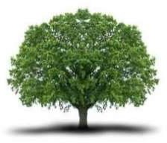
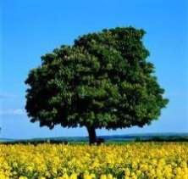
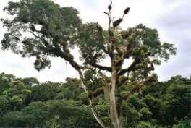
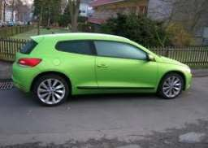


Overfitting
We want to learn models that are good at classifying unseen records
Overfitting: Learned models can fit the training data too closely and thus work poorly on unseen data
Model perfectly fitting the training data:
"Trees are big, green plants that have a trunk and no wheels“
– Unseen example:
Training data
– Goal: Find good compromise between specificness and generality of the learned model

Slide 29
Overfitting: Second Example
Example: Predict credit rating
possible decision tree:
Debts
>5000
Yes
No
-
+
Name | Net Income | Job status | Debts | Rating
John | 40000 | employed | 0 | +
Mary | 38000 | employed | 10000 | -
Stephen | 21000 | self-employed | 20000 | -
Eric | 2000 | student | 10000 | -
Alice | 35000 | employed | 4000 | +

Slide 30
Overfitting: Second Example
Name
=”John”
Example: Predict credit rating
alternative decision tree:
No
Yes
Name= “Alice”
+
Yes
No
+
-
Name | Net Income | Job status | Debts | Rating
John | 40000 | employed | 0 | +
Mary | 38000 | employed | 10000 | -
Stephen | 21000 | self-employed | 20000 | -
Eric | 2000 | student | 10000 | -
Alice | 35000 | employed | 4000 | +

Slide 31
Overfitting: Second Example
Both trees seem equally good
as they classify all instances in the training set correctly
− Which one do you prefer?
Name
=”John”
No
Yes
Name= “Alice”
+
Debts
>5000
Yes
No
Yes
No
+
-
-
+

Slide 32
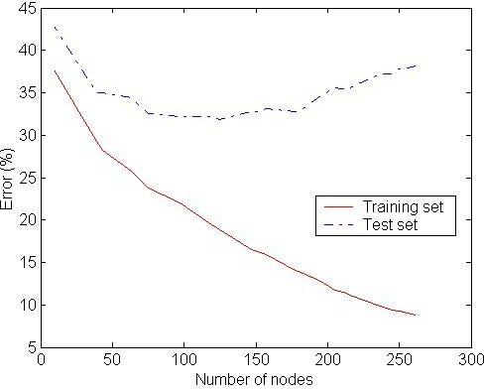
Overfitting: Symptoms and Causes
− Symptoms:
decision tree too deep
too many branches
model works well on training set but performs bad on test set
Overfitting
Typical causes of overfitting
noise / outliers in training data
too little training data
high model complexity
An overfitted model does not generalize well to unseen data.

Slide 33
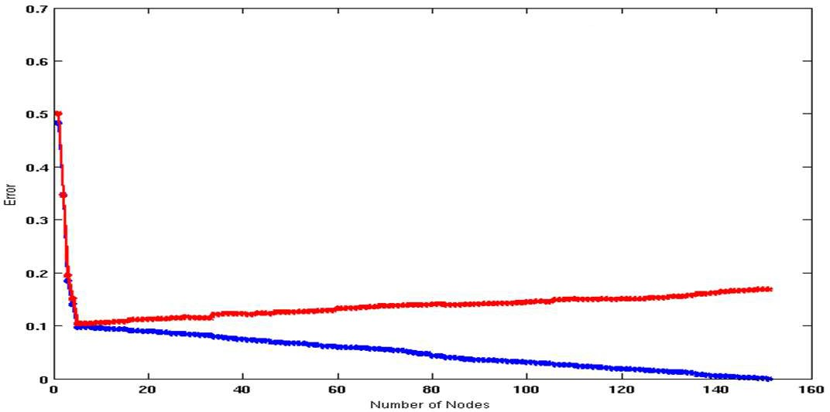
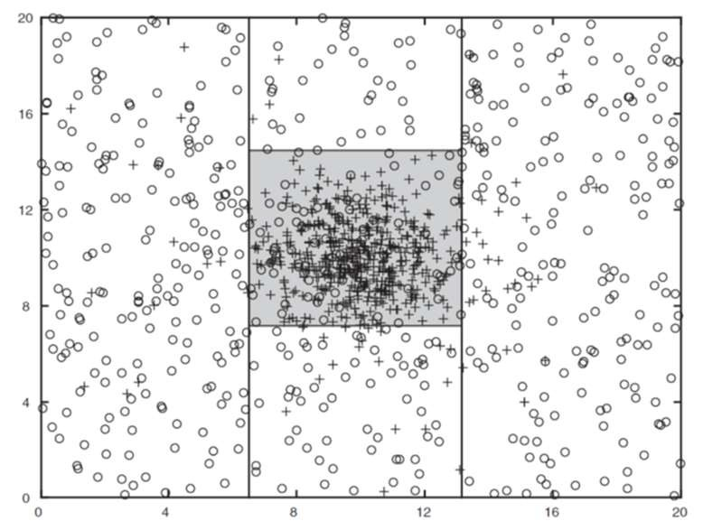
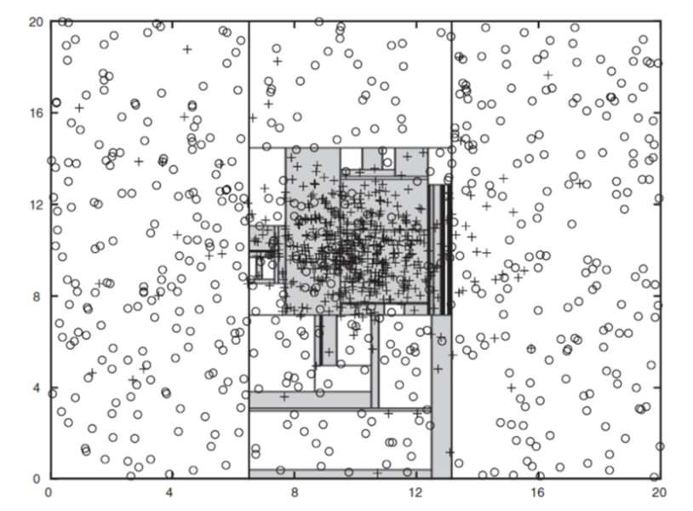

Underfitting versus Overfitting
Decision tree with 4 nodes
Decision tree with 50 nodes
Ideal model
Underfitting: when model is too simple, both training and test errors are large
Overfitting: when model is too complex, training error is small but test error is large

Slide 34
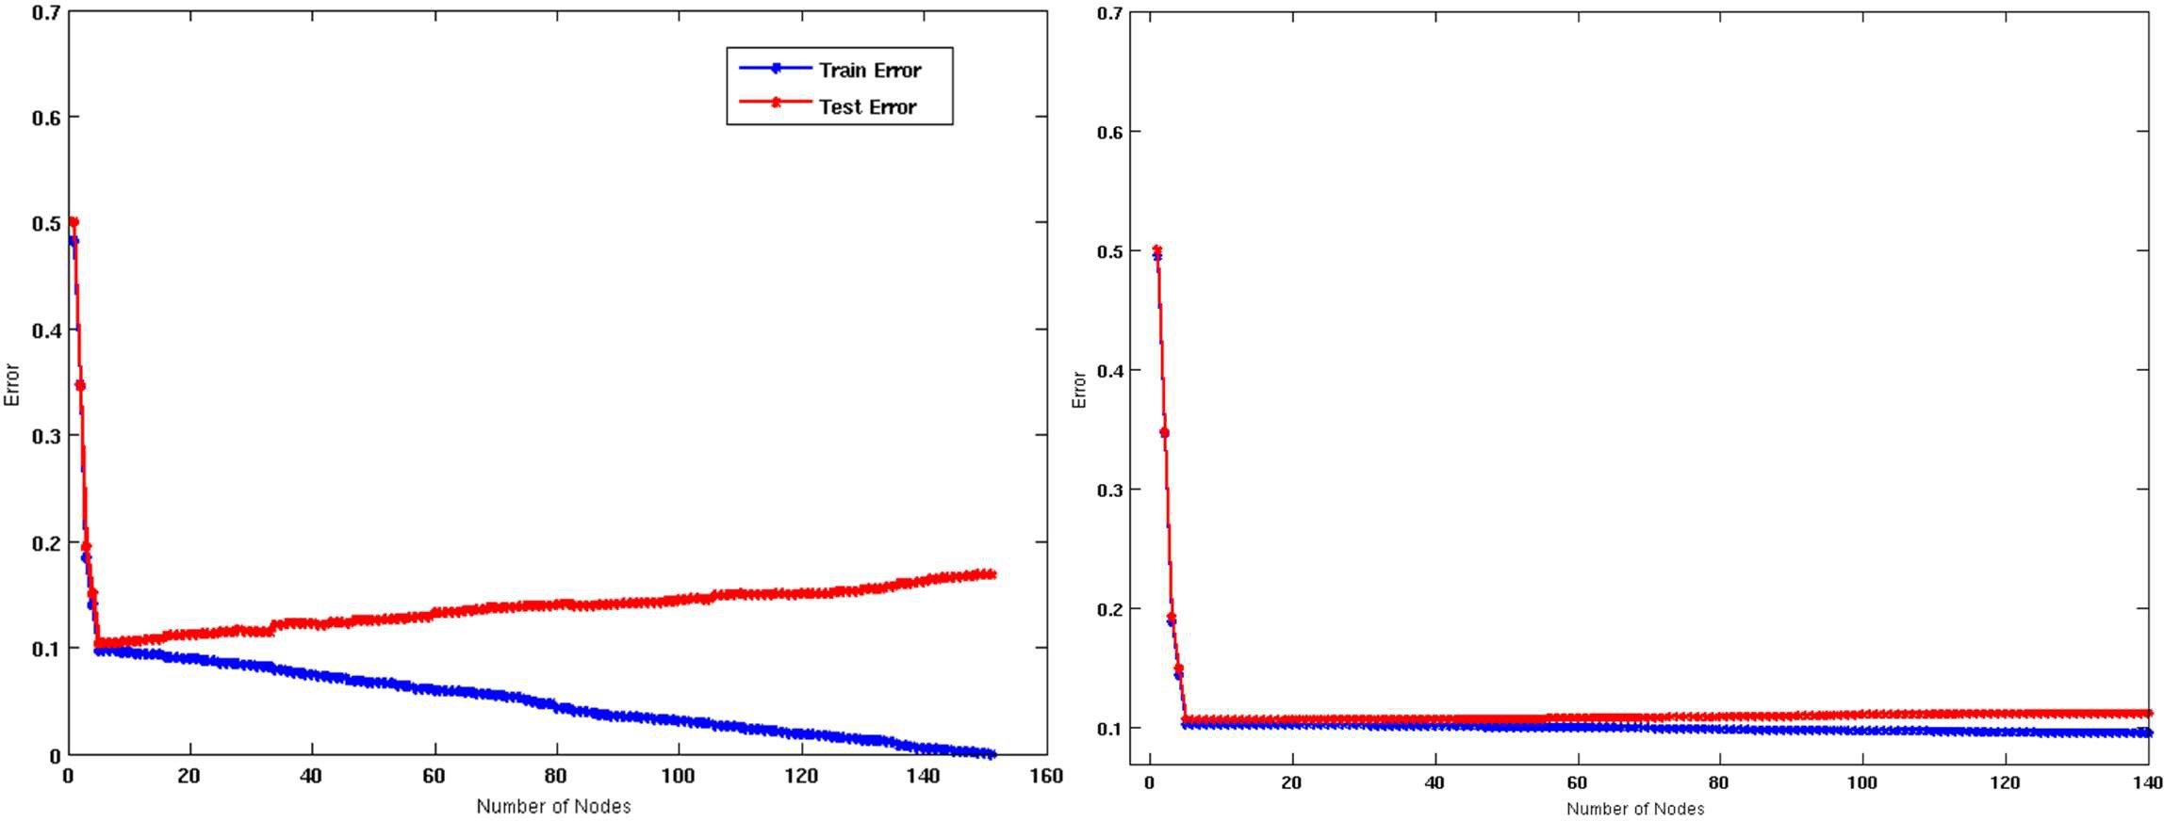
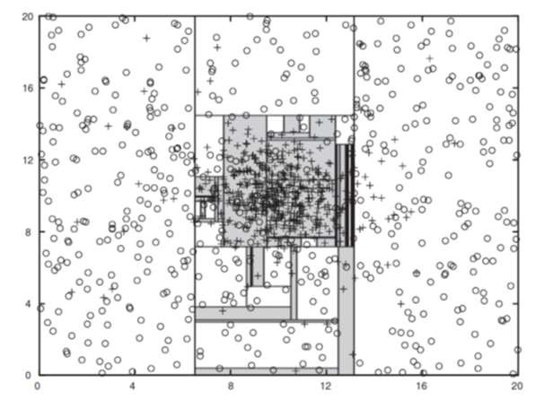
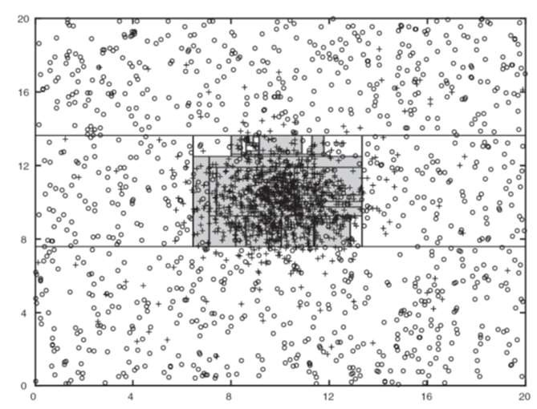
How to Prevent Overfitting 1: Use More Training Data
Twice the number of training examples
Decision Tree with 50 nodes
Decision Tree with 50 nodes
If training data is under-representative, training errors decrease but testing errors increase on increasing number of nodes
Increasing the size of training set reduces the difference between training and testing errors at a given number of nodes

Slide 35
How to Prevent Overfitting 2: Pre-Pruning
Stop the algorithm before tree becomes fully-grown
shallower tree potentially generalizes better (Occam’s razor)
Normal stopping conditions for a node (no pruning):
Stop if all instances belong to the same class
Stop if all the attribute values are the same
Early stopping conditions (pre-pruning):
Stop if number of instances within a leaf node is less than some user-specified threshold (e.g. leaf size < 4)
Stop if expanding the current node only slightly improves the impurity measure (e.g. gain < 0.01)
Stop splitting at a specific depth (e.g. maxDepth = 5)

Slide 36
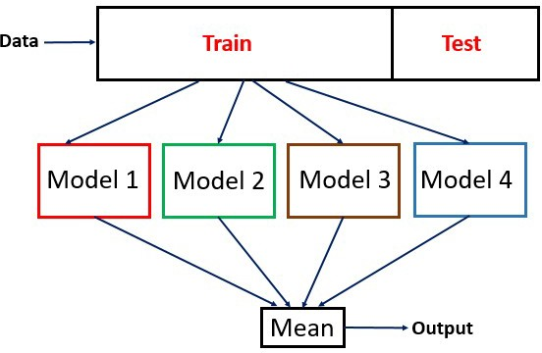
How to Prevent Overfitting 3: Ensembles
Lean different models (base learners)
Have them vote on the final classification decision
Vote
Idea: Wisdom of the crowds applied to classification
A single classifier might focus too much on one aspect
Multiple classifiers can focus on different aspects

Slide 37
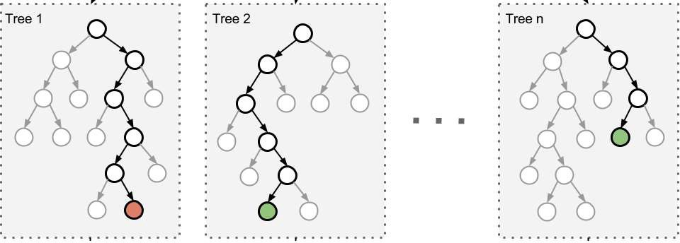
Random Forest
− Ensemble consisting of a large number of different decision trees
Vote
Classification
Independence of trees achieved by introducing randomness into the learning process
only use a random subset of the attributes at each split
learn on different random subsets of the data (bagging)
Random forests usually outperform single decision trees

Slide 38
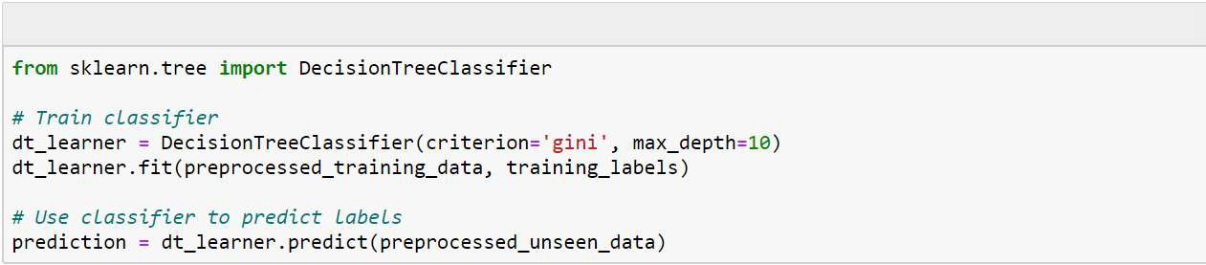
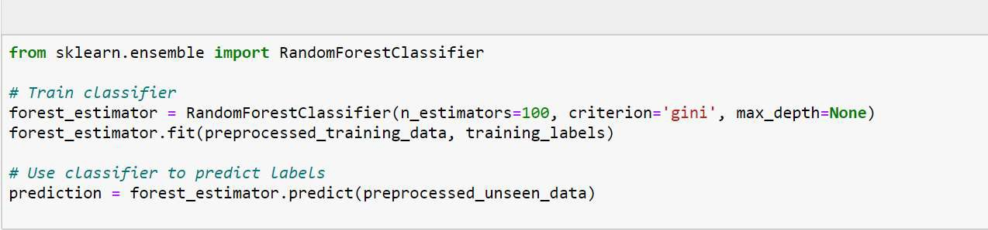
Decision Tree Classification in Python
Python
Random Forests in Python

Slide 39
Discussion of Decision Trees
Advantages
Inexpensive to construct
Extremely fast at classifying unknown records
Easy to interpret by humans for small-sized trees (eager learning)
Ignore irrelevant attributes (automatic feature selection)
Accuracy is comparable to other classification techniques for many low dimensional data sets (not texts and images)
Disadvantages
Space of possible decision trees is exponentially large. Greedy approaches are often unable to find the best tree
Trees do not consider interactions between attributes

